Slide 1
Microprocessor System Design AVR Microcontroller
Omid Fatemi

Slide 2
Contents
Introduction

Slide 3
Introduction
General-purpose microprocessor
CPU for Computers
No RAM, ROM, I/O on CPU chip itself
Example Intel’s x86, Motorola’s 680x0
Many chips on mother’s board
Data Bus
CPU
General-Purpose Micro-processor
Serial COM Port
RAM
ROM
I/O Port
Timer
Address Bus
General-Purpose Microprocessor System
Notes:
Intel’s x86 8086,8088,80386,80486, Pentium
Motorola’s 680x0 68000, 68010, 68020,68030,6040

Slide 4
Microcontroller
A smaller computer
On-chip RAM, ROM, I/O ports...
Example AVR, Intel’s 8051, Zilog’s Z8 and PIC 16X
CPU
RAM
ROM
A single chip
Serial COM Port
I/O Port
Timer
Microcontroller

Slide 5
Microprocessor vs. Microcontroller
Microprocessor
CPU is stand-alone, RAM, ROM, I/O, timer are separate
designer can decide on the amount of ROM, RAM and I/O ports.
More consumption power
More computing power
versatility
general-purpose
Microcontroller
CPU, RAM, ROM, I/O and timer are all on a single chip
fix amount of on-chip ROM, RAM, I/O ports
for applications in which cost, power and space are critical
Less applications
Notes:
Versatility: any number of applications for PC

Slide 6
Embedded System
Embedded system means the processor is embedded into that application.
An embedded product uses a microprocessor or microcontroller to do one task only.
In an embedded system, there is only one application software that is typically burned into ROM.
Example printer, keyboard, video game player
Notes:
A printer is an example of embedded system since the processor inside it performs one task only.

Slide 7
Three Criteria in Choosing a Microcontroller
meeting the computing needs of the task efficiently and cost effectively
speed, the amount of ROM and RAM, the number of I/O ports and timers, size, packaging, power consumption
easy to upgrade
cost per unit
availability of software development tools
assemblers, debuggers, C compilers, in circuit emulator, simulator, technical support
wide availability and reliable sources for the microcontroller.

Slide 8
General Purpose Microprocessors vs. Microcontrollers
General Purpose Microprocessors
General
Purpose
Micro
processor
Data BUS
RAM
ROM
Timer
Serial
COM
Port
IO
Port
Address BUS
Control BUS
Microcontrollers
CPU
RAM
ROM
Serial
Port
Timer
I/O

Slide 9
Most common microcontrollers
8-bit microcontrollers
AVR
PIC
HCS12
8051
32-bit microcontrollers
ARM
PIC32

Slide 10
AVR internal architecture

Slide 11
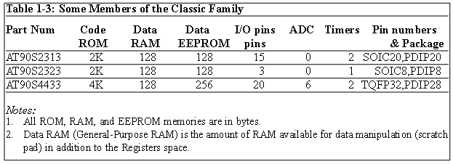
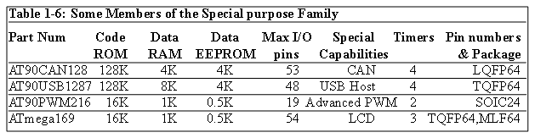
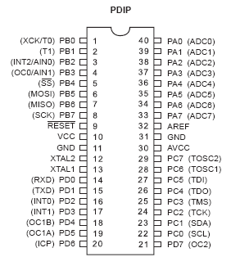
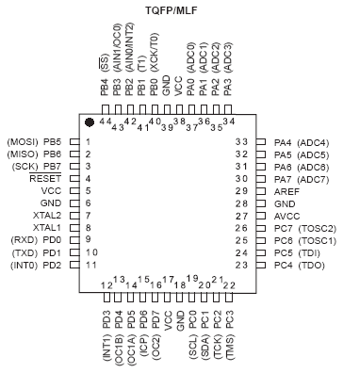
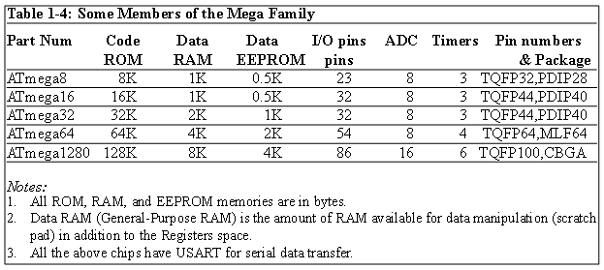
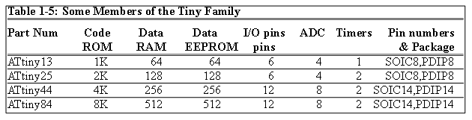
AVR different groups
Classic AVR
e.g. AT90S2313, AT90S4433
Mega
e.g. ATmega8, ATmega32, ATmega128
Tiny
e.g. ATtiny13, ATtiny25
Special Purpose AVR
e.g. AT90PWM216,AT90USB1287
Notes:
Plastic Dual Inline Package
Thin Quad Flat Package
Micro Lead Frame
Small Outline integrated circuit
Low profile Quad flat

Slide 12
Let’s get familiar with the AVR part numbers
ATmega128
Atmel
group
Flash =128K
ATtiny44
AT90S4433
Atmel
Tiny group
Flash =4K
Atmel
Classic group
Flash =4K

Slide 13

Introduction to Assembly Chapter 2
The AVR microcontroller
and embedded
systems
using assembly and c

Slide 14
Topics
AVR’s CPU
Its architecture
Some simple programs
Data Memory access
Program memory
RISC architecture

Slide 15
AVR’s CPU
AVR’s CPU
ALU
32 General Purpose registers (R0 to R31)
PC register
Instruction decoder
CPU
ALU
R0
R1
R2
…
SREG:
H
N
Z
I
T
S
V
C
R15
R16
R17
PC
…
Instruction decoder
R30
R31
Instruction Register
registers

Slide 16
Some simple instructions 1. Loading values into the general purpose registers
LDI (Load Immediate)
LDI Rd, k
Its equivalent in high level languages:
Rd = k
Example:
LDI R16,53
R16 = 53
LDI R19,132
LDI R23,0x27
R23 = 0x27
CPU
ALU
R0
R1
R2
…
SREG:
H
N
Z
I
T
S
V
C
R15
R16
R17
PC
…
Instruction decoder
R30
R31
Instruction Register
registers

Slide 17
Some simple instructions 2. Arithmetic calculation
There are some instructions for doing Arithmetic and logic operations; such as:
ADD, SUB, MUL, AND, etc.
ADD Rd,Rs
Rd = Rd + Rs
Example:
ADD R25, R9
R25 = R25 + R9
ADD R17,R30
R17 = R17 + R30
CPU
ALU
R0
R1
R2
…
SREG:
H
N
Z
I
T
S
V
C
R15
R16
R17
PC
…
Instruction decoder
R30
R31
Instruction Register
registers

Slide 18
A simple program
Write a program that calculates 19 + 95
LDI R16, 19 ;R16 = 19
LDI R20, 95 ;R20 = 95
ADD R16, R20 ;R16 = R16 + R20
CPU
ALU
R0
R1
R2
…
SREG:
H
N
Z
I
T
S
V
C
R15
R16
R17
PC
…
Instruction decoder
R30
R31
Instruction Register
registers

Slide 19
A simple program
Write a program that calculates 19 + 95 + 5
LDI R16, 19 ;R16 = 19
LDI R20, 95 ;R20 = 95
LDI R21, 5 ;R21 = 5
ADD R16, R20 ;R16 = R16 + R20
ADD R16, R21 ;R16 = R16 + R21
LDI R16, 19 ;R16 = 19
LDI R20, 95 ;R20 = 95
ADD R16, R20 ;R16 = R16 + R20
LDI R20, 5 ;R20 = 5
ADD R16, R20 ;R16 = R16 + R20

Slide 20
Some simple instructions 2. Arithmetic calculation
SUB Rd,Rs
Rd = Rd - Rs
Example:
SUB R25, R9
R25 = R25 - R9
SUB R17,R30
R17 = R17 - R30
CPU
ALU
R0
R1
R2
…
SREG:
H
N
Z
I
T
S
V
C
R15
R16
R17
PC
…
Instruction decoder
R30
R31
Instruction Register
registers

Slide 21
Some simple instructions 2. Arithmetic calculation
INC Rd
Rd = Rd + 1
Example:
INC R25
R25 = R25 + 1
DEC Rd
Rd = Rd - 1
Example:
DEC R23
R23 = R23 - 1
CPU
ALU
R0
R1
R2
…
SREG:
H
N
Z
I
T
S
V
C
R15
R16
R17
PC
…
Instruction decoder
R30
R31
Instruction Register
registers

Slide 22
Data Address Space
Example: Add contents of location 0x90 to contents of location 0x95 and store the result in location 0x313.
Example: Store 0x53 into the SPH register. The address of SPH is 0x5E
Example: What does the following instruction do?
LDS R20,2
LDS (Load direct from data space)
STS (Store direct to data space)
Example: Write a program that stores 55 into location 0x80 of RAM.
Example: Write a program that copies the contents of location 0x80 of RAM into location 0x81.
Solution:
LDS R20, 0x90 ;R20 = [0x90]
LDS R21, 0x95 ;R21 = [0x95]
ADD R20, R21 ;R20 = R20 + R21
STS 0x313, R20 ;[0x313] = R20
LDS Rd, addr ;Rd = [addr]
STS addr,Rd ;[addr]=Rd
Solution:
LDI R20, 0x53 ;R20 = 0x53
STS 0x5E, R20 ;SPH = R20
Solution:
LDI R20, 55 ;R20 = 55
STS 0x80, R20 ;[0x80] = R20 = 55
Answer:
It copies the contents of R2 into R20; as 2 is the address of R2.
Example:
LDS R1, 0x60
Example:
STS 0x60,R15 ; [0x60] = R15
Solution:
LDS R20, 0x80 ;R20 = [0x80]
STS 0x81, R20 ;[0x81] = R20 = [0x80]

Slide 23
Data Address Space
Example: Write a program that adds the contents of the PINC IO register to the contents of PIND and stores the result in location 0x90 of the SRAM
OUT (OUT to IO location)
IN (IN from IO location)
Solution:
IN R20,PINC ;R20 = PINC
IN R21,PIND ;R21 = PIND
ADD R20,R21 ;R20 = R20 + R21
STS 0x90,R20 ;[0x90] = R20
OUT IOAddr,Rd ;[addr]=Rd
IN Rd,IOaddress ;Rd = [addr]
Using Names of IO registers
Example:
OUT SPH,R12 ;OUT 0x3E,R12
IN R15,SREG ;IN R15,0x3F
Example:
OUT 0x3F,R12 ;SREG = R12
OUT 0x3E,R15 ;SPH = R15
Example:
IN R1, 0x3F ;R1 = SREG
IN R17,0x3E ;R17 = SPH

Slide 24
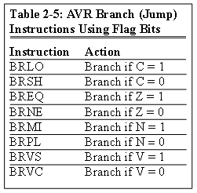
Status Register (SREG)
SREG:
I
T
H
S
V
N
Z
C
Interrupt
Carry
oVerflow
Zero
Temporary
Sign
N+V
Negative
Half carry
Example: Show the status of the C, H, and Z flags after the subtraction of 0x9C from 0x9C in the following instructions:
LDI R20, 0x9C
LDI R21, 0x9C
SUB R20, R21 ;subtract R21 from R20
Example: Show the status of the C, H, and Z flags after the subtraction of 0x23 from 0xA5 in the following instructions:
LDI R20, 0xA5
LDI R21, 0x23
SUB R20, R21 ;subtract R21 from R20
Example: Show the status of the C, H, and Z flags after the subtraction of 0x73 from 0x52 in the following instructions:
LDI R20, 0x52
LDI R21, 0x73
SUB R20, R21 ;subtract R21 from R20
Example: Show the status of the C, H, and Z flags after the addition of 0x9C and 0x64 in the following instructions:
LDI R20, 0x9C
LDI R21, 0x64
ADD R20, R21 ;add R21 to R20
Example: Show the status of the C, H, and Z flags after the addition of 0x38 and 0x2F in the following instructions:
LDI R16, 0x38 ;R16 = 0x38
LDI R17, 0x2F ;R17 = 0x2F
ADD R16, R17 ;add R17 to R16
CPU
ALU
R0
R1
R2
…
SREG:
Solution:
$52 0101 0010
- $73 0111 0011
$DF 1101 1111 R20 = $DF
C = 1 because R21 is bigger than R20 and there is a borrow from D8 bit.
Z = 0 because the R20 has a value other than zero after the subtraction.
H = 1 because there is a borrow from D4 to D3.
I
T
H
S
V
N
Z
C
Solution:
$9C 1001 1100
- $9C 1001 1100
$00 0000 0000 R20 = $00
C = 0 because R21 is not bigger than R20 and there is no borrow from D8 bit.
Z = 1 because the R20 is zero after the subtraction.
H = 0 because there is no borrow from D4 to D3.
Solution:
$A5 1010 0101
- $23 0010 0011
$82 1000 0010 R20 = $82
C = 0 because R21 is not bigger than R20 and there is no borrow from D8 bit.
Z = 0 because the R20 has a value other than 0 after the subtraction.
H = 0 because there is no borrow from D4 to D3.
Solution: 1
$9C 1001 1100
+ $64 0110 0100
$100 1 0000 0000 R20 = 00
C = 1 because there is a carry beyond the D7 bit.
H = 1 because there is a carry from the D3 to the D4 bit.
Z = 1 because the R20 (the result) has a value 0 in it after the addition.
Solution: 1
$38 0011 1000
+ $2F 0010 1111
$67 0110 0111 R16 = 0x67
C = 0 because there is no carry beyond the D7 bit.
H = 1 because there is a carry from the D3 to the D4 bit.
Z = 0 because the R16 (the result) has a value other than 0 after the addition.
R15
R16
R17
PC
…
Instruction decoder
R30
R31
Instruction Register
registers
Notes:
BRBC s, k Branch if Status Flag Cleared if (SREG(s) = 0) then PC ¬ PC+k + 1 None 1 / 2
BREQ k Branch if Equal if (Z = 1) then PC ¬ PC + k + 1 None 1 / 2
BRNE k Branch if Not Equal if (Z = 0) then PC ¬ PC + k + 1 None 1 / 2
BRCS k Branch if Carry Set if (C = 1) then PC ¬ PC + k + 1 None 1 / 2
BRCC k Branch if Carry Cleared if (C = 0) then PC ¬ PC + k + 1 None 1 / 2
BRSH k Branch if Same or Higher if (C = 0) then PC ¬ PC + k + 1 None 1 / 2
BRLO k Branch if Lower if (C = 1) then PC ¬ PC + k + 1 None 1 / 2
BRMI k Branch if Minus if (N = 1) then PC ¬ PC + k + 1 None 1 / 2
BRPL k Branch if Plus if (N = 0) then PC ¬ PC + k + 1 None 1 / 2
BRGE k Branch if Greater or Equal, Signed if (N Å V= 0) then PC ¬ PC+ k + 1 None 1 / 2
BRLT k Branch if Less Than, Signed if (N Å V= 1) then PC ¬ PC + k + 1 None 1 / 2
BRHS k Branch if Half Carry Flag Set if (H = 1) then PC ¬ PC + k + 1 None 1 / 2
BRHC k Branch if Half Carry Flag Cleared if (H = 0) then PC ¬ PC + k + 1 None 1 / 2
BRTS k Branch if T Flag Set if (T = 1) then PC ¬ PC + k + 1 None 1 / 2
BRTC k Branch if T Flag Cleared if (T = 0) then PC ¬ PC + k + 1 None 1 / 2
BRVS k Branch if Overflow Flag is Set if (V = 1) then PC ¬ PC + k + 1 None 1 / 2
BRVC k Branch if Overflow Flag is Cleared if (V = 0) then PC ¬ PC + k + 1 None 1 / 2
BRIE k Branch if Interrupt Enabled if (I = 1) then PC ¬ PC + k + 1 None 1 / 2
BRID k Branch if Interrupt Disabled if (I = 0) then PC ¬ PC + k + 1 None 1 / 2

Slide 25
Assembler Directives .EQU and .SET
.EQU name = value
Example:
.EQU COUNT = 0x25
LDI R21, COUNT ;R21 = 0x25
LDI R22, COUNT + 3 ;R22 = 0x28
.SET name = value
Example:
.SET COUNT = 0x25
LDI R21, COUNT ;R21 = 0x25
LDI R22, COUNT + 3 ;R22 = 0x28
.SET COUNT = 0x19
LDI R21, COUNT ;R21 = 0x19
Notes:
.set could be changed.
But .equ can’t

Slide 26
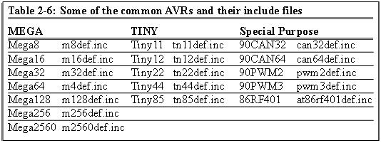
Assembler Directives .INCLUDE
.INCLUDE “filename.ext”
M32def.inc
.equ SREG = 0x3f
.equ SPL = 0x3d
.equ SPH = 0x3e
....
.equ INT_VECTORS_SIZE = 42 ; size in words
Program.asm
.INCLUDE “M32DEF.INC”
LDI R20, 10
OUT SPL, R20

Slide 27
Assembler Directives .ORG
.ORG address
00 E205
01 0000
02 0000
03 0000
04 0000
05 0000
06 0000
07 E314
08 E321
09 0000
0A 0000
Program.asm
.ORG 0
LDI R16, 0x25
.ORG 0x7
LDI R17, 0x34
LDI R18, 0x31
assembler

Slide 28
Assembler
Assembly
assembler
Machine
Language

Slide 29
Flash memory and PC register
LDI R16, 0x25
LDI R17, $34
LDI R18, 0x31
ADD R16, R17
ADD R16, R18
LDI R17, 11
ADD R16, R17
STS SUM, R16
HERE:JMP HERE
00 E205
01 E314
02 E321
03 0F01
04 0F02
05 E01B
06 0F01
07 9300
08 0300
09 940C
0A 0009
E205
E314
E321
0F01
0F02
16-bit
E01B
0F01
9300
0300
940C
0009
3
0
9
1
5
2
7
A
4
8
B
6

Slide 30
Fetch and execute
Old Architectures
00 E205
01 E314
02 E321
03 0F01
04 0F02
05 E01B
06 0F01
07 9300
08 0300
09 940C
0A 0009
Instruct 4
Instruct 3
Instruct 2
Instruct 1
16-bit
Fetch
Execute

Slide 31
Pipelining
Pipelining
00 E205
01 E314
02 E321
03 0F01
04 0F02
05 E01B
06 0F01
07 9300
08 0300
09 940C
0A 0009
Instruct 4
Instruct 3
Instruct 2
16-bit
Instruct 1
Fetch
Execute

Slide 32
How to speed up the CPU
Increase the clock frequency
More frequency ➔ More power consumption & more heat
Limitations
Change the architecture
Pipelining
RISC

Slide 33
Changing the architecture RISC vs. CISC
CISC (Complex Instruction Set Computer)
Put as many instruction as you can into the CPU
RISC (Reduced Instruction Set Computer)
Reduce the number of instructions, and use your facilities in a more proper way.

Slide 34
RISC architecture
Feature 1
RISC processors have a fixed instruction size. It makes the task of instruction decoder easier.
In AVR the instructions are 2 or 4 bytes.
In CISC processors instructions have different lengths
E.g. in 8051
CLR C ; a 1-byte instruction
ADD A, #20H ; a 2-byte instruction
LJMP HERE ; a 3-byte instruction

Slide 35
RISC architecture
Feature 2: reduce the number of instructions
Pros: Reduces the number of used transistors
Cons:
Can make the assembly programming more difficult
Can lead to using more memory

Slide 36
RISC architecture
Feature 3: limit the addressing mode
Advantage
hardwiring
Disadvantage
Can make the assembly programming more difficult

Slide 37
RISC architecture
Feature 4: Load/Store
LDS R20, 0x200
LDS R21, 0x220
ADD R20, R21
STS 0x230, R20

Slide 38
RISC architecture
LDS R20, 0x100 ; R20 = [0x100]
ADD R20,R21 ; R20 = R20 + R21
ADD R20, R21
LDS R20, 0x100
Feature 5 (Harvard architecture): separate buses for opcodes and operands
Advantage: opcodes and operands can go in and out of the CPU together.
Disadvantage: leads to more cost in general purpose computers.
Fetch
Execute
CPU
Code
Memory
Control bus
Control bus
Data
Memory
Data bus
Data bus
Address bus
Address bus

Slide 39
RISC architecture
Feature 6: more than 95% of instructions are executed in 1 machine cycle

Slide 40
RISC architecture
Feature 7
RISC processors have at least 32 registers. Decreases the need for stack and memory usages.
In AVR there are 32 general purpose registers (R0 to R31)

